Slide 1
The Great Derangement: Climate Change and the Unthinkable- Impressions
Milind Kumar V

Slide 2
What?
Non-fiction by Amitav Ghosh
A book about climate change
Analyzed through the lens of
Literature- novel in particular
History
Politics
Notes:
Complex read-
Multiple intricate counter-intuitive arguments
Not statistics based arguments

Slide 3
Stories

Slide 4
The Great Derangement?
“In a substantially altered world, when sea-level rise has swallowed the Sundarbans and made cities like Kolkata, New York and Bangkok uninhabitable, when readers and museumgoers turn to the art and literature of our time, will they not look, first, and most urgently, for traces and portents of the altered world of their inheritance? And when they fail to find them, what should they- what can they- do other than to conclude that ours was a time when most forms of art and literature were drawn into the modes of concealment that prevented people from recognizing the realities of their plight? Quite possible then, this era, which so congratulates itself on its self-awareness, will come to be known as the time of the Great Derangement.”
Why is climate change so elusive?
Notes:
Literature and art have shaped culture by reflecting the times
Counterculture- Jack Kerbouac’s on the road, ken kesey’s a bird flew over the cuckoo’s nest
During revolutions
However, climate change is tricky to grasp- especially in the novel

Slide 5

probability!
Notes:
Certain stories that pervade the popular consciousness have extraordinary events happen in them - arabian knights, jataka tales or the like
However, the modern novel strives to push the extraordinary to the background in order to be considered serious fiction- it requires a kind of regularity, a depiction of a kind of bourgeois life
Extraordinary events that are even slightly improbable in real life seem extraordinarily unlikely and are frowned upon in fiction- these seem like the a desperate author grasping at straws to move the plot along
But climate change is full of extraordinary events- cyclones in the Arabian sea, 1978 tornado in Delhi which the author encountered, flash floods, hurricanes, wildfires- all of which are hard to feature in a novel without it seeming outlandish
This can even be seen in architecture with constructions in Mumbai, Andaman and Nicobar etc. right out near the sea- with little thought for what it can unleash

Slide 6
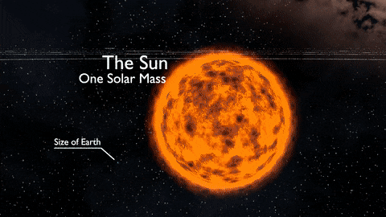
Again, why is climate change so elusive?
Climate change happens over time and spatial scales that are difficult to capture in the modern novel.
Source
Notes:
Same oceans flooding different continents, same deserts, same wildfires- geological processes happening over years

Slide 7
Individual moral adventure over stories of the collective.

Slide 8
History

Slide 9
Focus on Asia
Lifestyle shifts have accelerated climate change
Asia- large and “developing” populations
Decolonisation directly affected the shift towards a Carbon economy
Climate justice?

Slide 10
Politics

Slide 11
Challenges of the politics of climate change
Politics is increasingly a moral journey and performance centered
Divergence between the will of the governed and actual policy
Deep state
Fossil fuels = power
Shift from coal to petroleum: loss of control and leverage
Notes:
Morality - Iraq war
Power- ronal reagan- our way of life

Slide 12
More counter intuitive challenges
Problem of commons
Moral arguments allow media/opposition to hijack discussion
Be the change you wanna be?
Global inaction- politics of the armed lifeboat

Slide 13
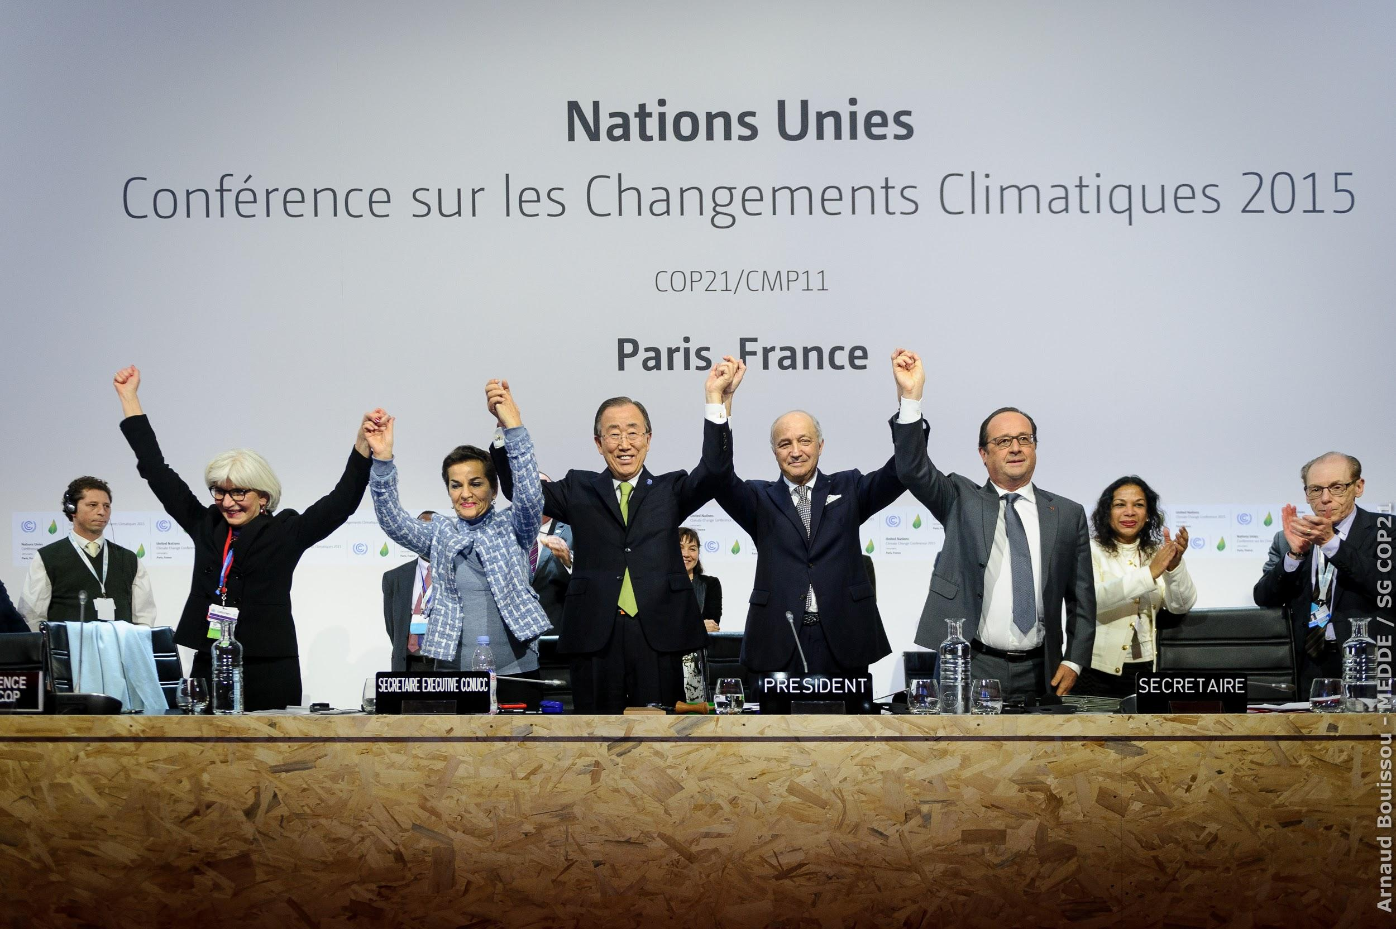

A case study
Source
Source
Notes:
Paris accords- no mention of climate justice or redistribution of power, intricate and worded like religious prose, places it’s faith in technologies that are far from complete, no criticism of infinte growth, corporations, public officials and entrepreneurs making each other rich, activism and protests prevented- with terror attacks as an excuse- surveillance state
Laudato si’ - accepts human weakness, limitations, is critical of existent paradigms
Religion the answer

Slide 14
Thank you!

Slide 15
Sources
Ghosh, Amitav. The great derangement: Climate change and the unthinkable. Penguin UK, 2018.
https://blogs.lse.ac.uk/lsereviewofbooks/2017/07/20/book-review-the-great-derangement-climate-change-and-the-unthinkable-by-amitav-ghosh/
https://www.livemint.com/Leisure/JwugTXAn0AHsGECTWuYZfP/Book-review-The-Great-Derangement-by-Amitav-Ghosh.html

